Slide 1


COVID-19 Claims –
Food Employers Labor Relations Association and United Food & Commercial Workers’ VEBA Fund
Flex Link
Last data refresh:
2/16/2022 2:09:14 PM UTC
Downloaded at:
2/19/2022 2:02:51 PM UTC

Slide 2
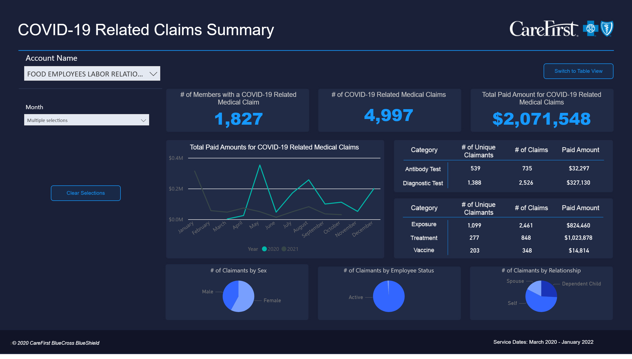
COVID-19 Related Claims Summary
Notes:
# of COVID-19 Related Medical Claims
No alt text provided
textbox
No alt text provided
actionButton
No alt text provided
Procedure Code
No alt text provided
Total Paid Amount for COVID-19 Related Medical Claims
No alt text provided
# of Members with a COVID-19 Related Medical Claim
No alt text provided
actionButton
No alt text provided
actionButton
No alt text provided
Total Paid Amounts for COVID-19 Related Medical Claims
No alt text provided
Account Name
No alt text provided
# of Claimants by Sex
No alt text provided
# of Claimants by Employee Status
No alt text provided
# of Claimants by Relationship
No alt text provided
actionButton
No alt text provided
basicShape
No alt text provided
textbox
No alt text provided
tableEx
No alt text provided
card
No alt text provided
card
No alt text provided
card
No alt text provided
card
No alt text provided
card
No alt text provided
card
No alt text provided
card
No alt text provided
card
No alt text provided
card
No alt text provided
card
No alt text provided
card
No alt text provided
card
No alt text provided
card
No alt text provided
tableEx
No alt text provided
actionButton
No alt text provided
actionButton
No alt text provided
card
No alt text provided
card
No alt text provided
card
No alt text provided

Slide 3
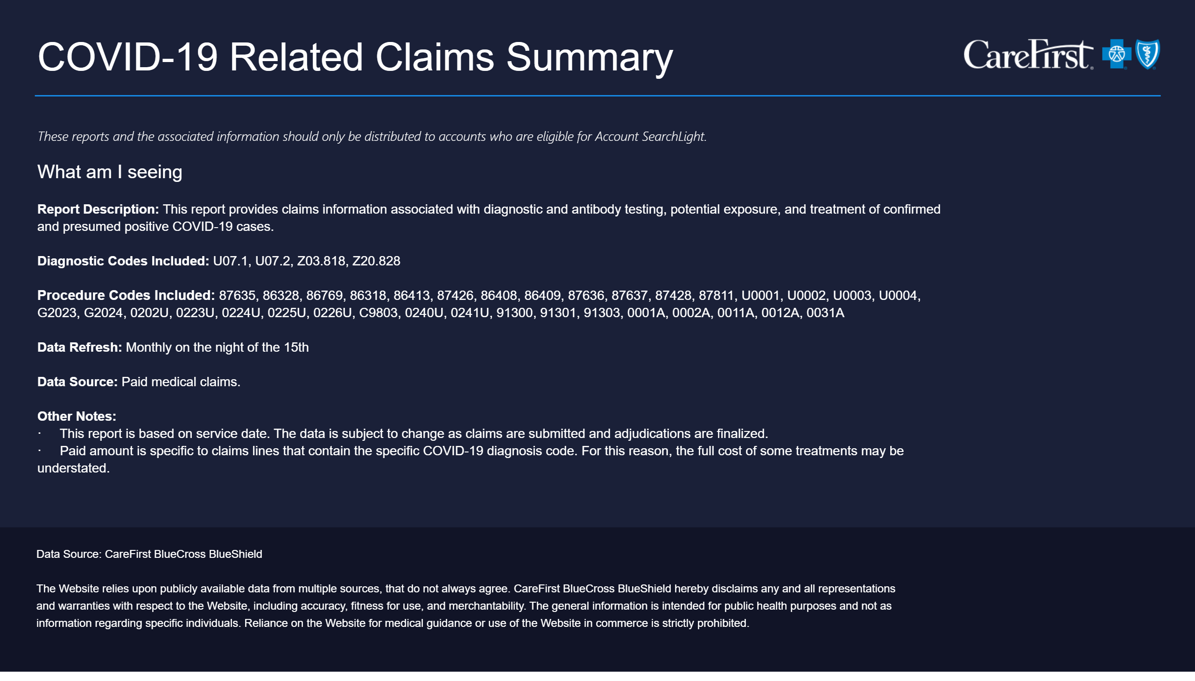
Info Guide - COVID-19 Related Claims Summary
Notes:
textbox
No alt text provided
textbox
No alt text provided
textbox
No alt text provided

Slide 4
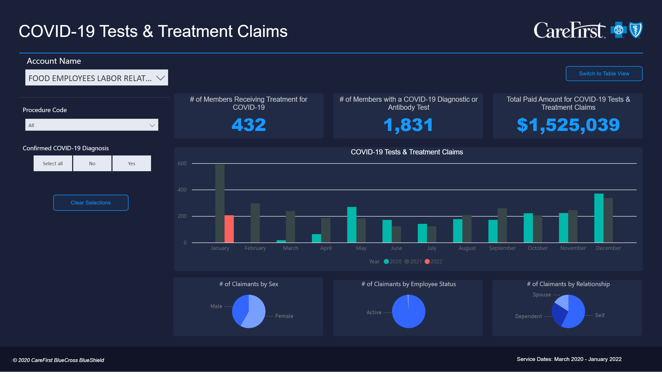
COVID-19 Tests & Treatment Claims
Notes:
actionButton
No alt text provided
map
No alt text provided
columnChart
No alt text provided
columnChart
No alt text provided
# of Members with a COVID-19 Diagnostic or Antibody Test
No alt text provided
textbox
No alt text provided
actionButton
No alt text provided
Procedure Code
No alt text provided
Total Paid Amount for COVID-19 Tests & Treatment Claims
No alt text provided
Account Name
No alt text provided
COVID-19 Tests & Treatment Claims
No alt text provided
Confirmed COVID-19 Diagnosis
No alt text provided
# of Members Receiving Treatment for COVID-19
No alt text provided
# of Claimants by Sex
No alt text provided
# of Claimants by Employee Status
No alt text provided
# of Claimants by Relationship
No alt text provided
tableEx
No alt text provided
actionButton
No alt text provided
actionButton
No alt text provided
actionButton
No alt text provided
basicShape
No alt text provided
textbox
No alt text provided
card
No alt text provided

Slide 5
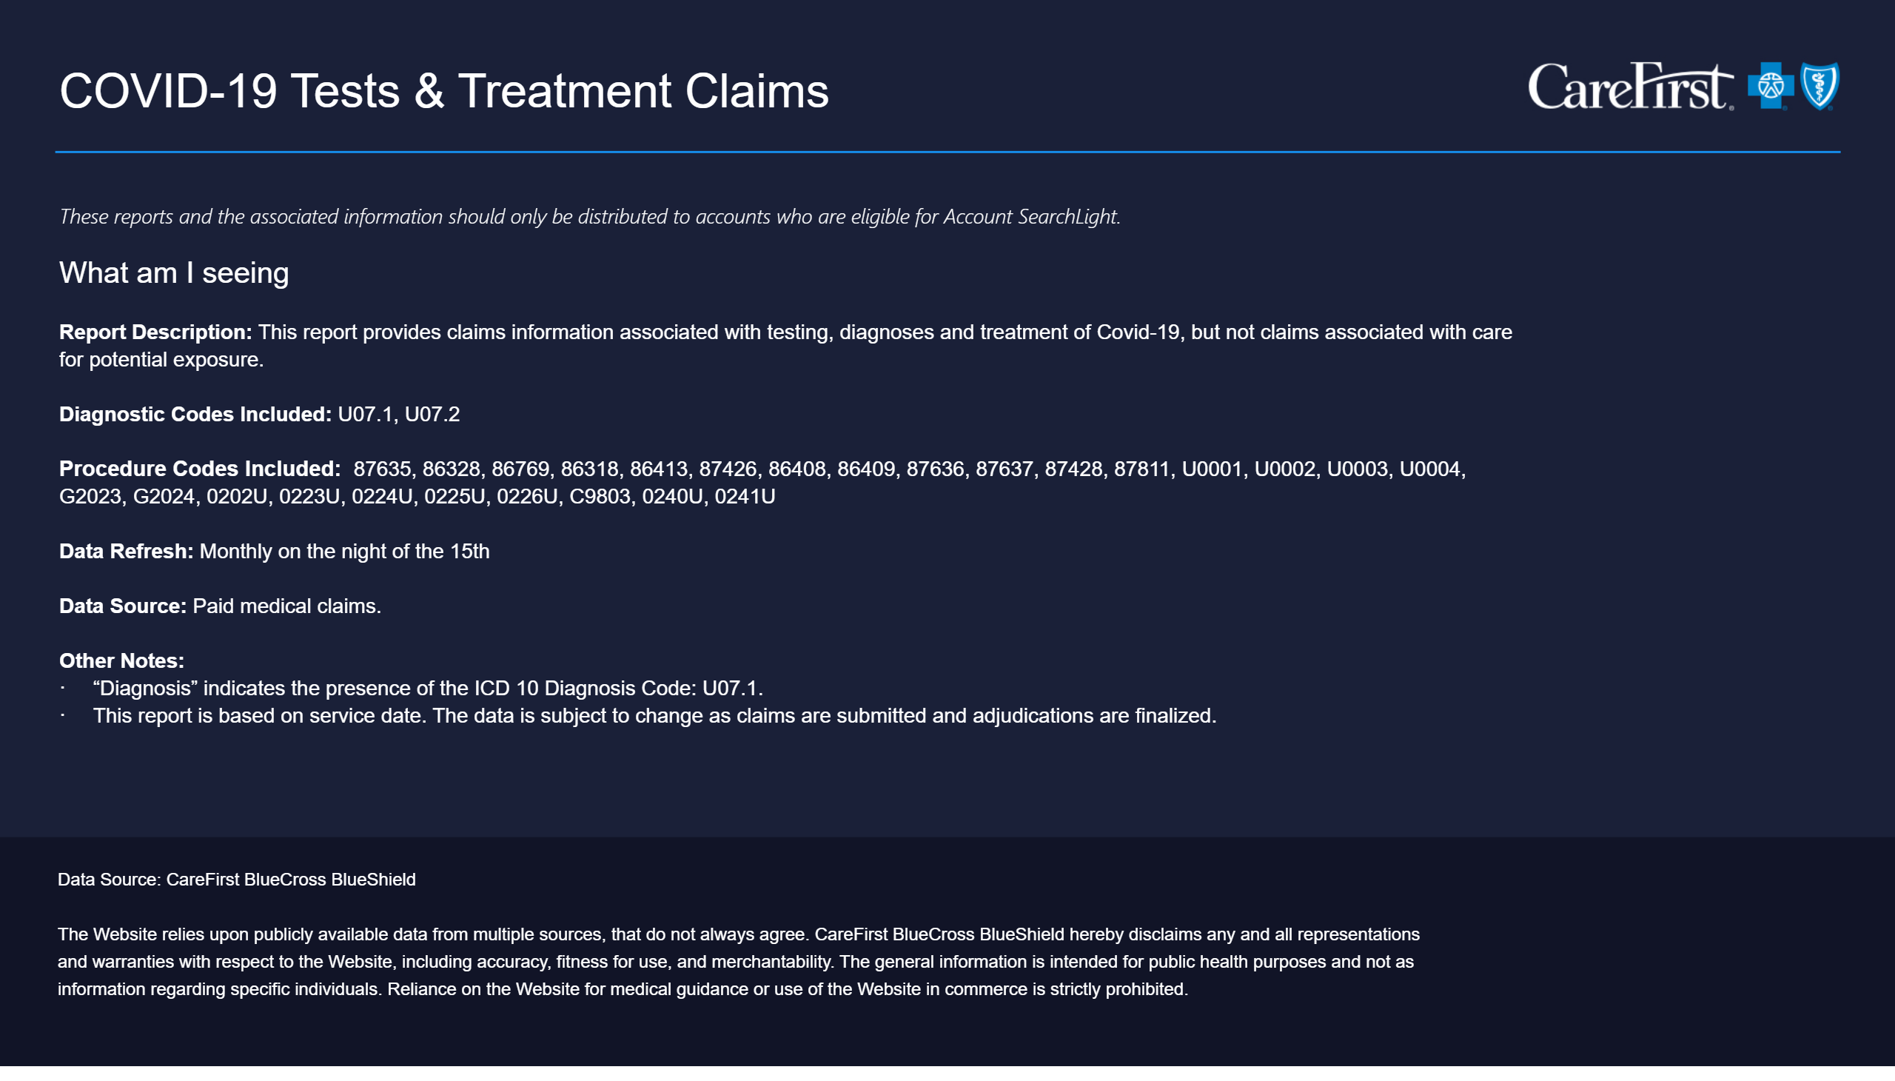
Info Guide - COVID-19 Tests & Treatment Claims
Notes:
textbox
No alt text provided
textbox
No alt text provided
textbox
No alt text provided

Slide 6
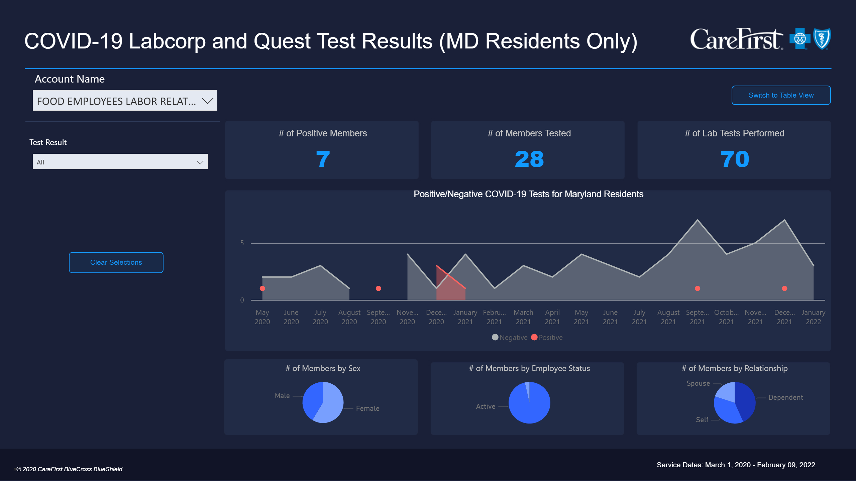
COVID-19 Labcorp and Quest Test Results for MD Residents Only
Notes:
# of Members by Sex
No alt text provided
# of Members by Relationship
No alt text provided
# of Members Tested
No alt text provided
textbox
No alt text provided
# of Members by Employee Status
No alt text provided
Test Result
No alt text provided
# of Lab Tests Performed
No alt text provided
Positive/Negative COVID-19 Tests for Maryland Residents
No alt text provided
# of Positive Members
No alt text provided
actionButton
No alt text provided
Account Name
No alt text provided
basicShape
No alt text provided
textbox
No alt text provided
actionButton
No alt text provided
tableEx
No alt text provided
actionButton
No alt text provided
actionButton
No alt text provided
card
No alt text provided

Slide 7
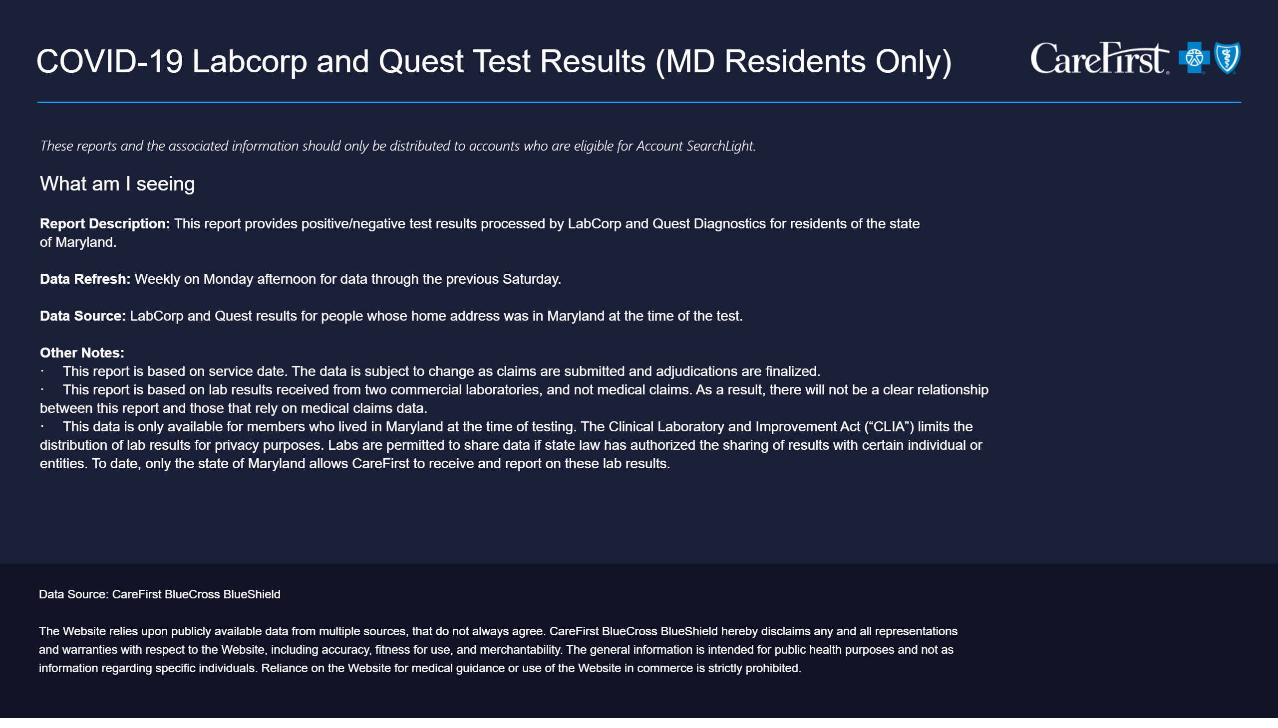
Info Guide - COVID-19 Labcorp and Quest Test Results for MD Residents Only
Notes:
textbox
No alt text provided
textbox
No alt text provided
textbox
No alt text provided

Slide 8
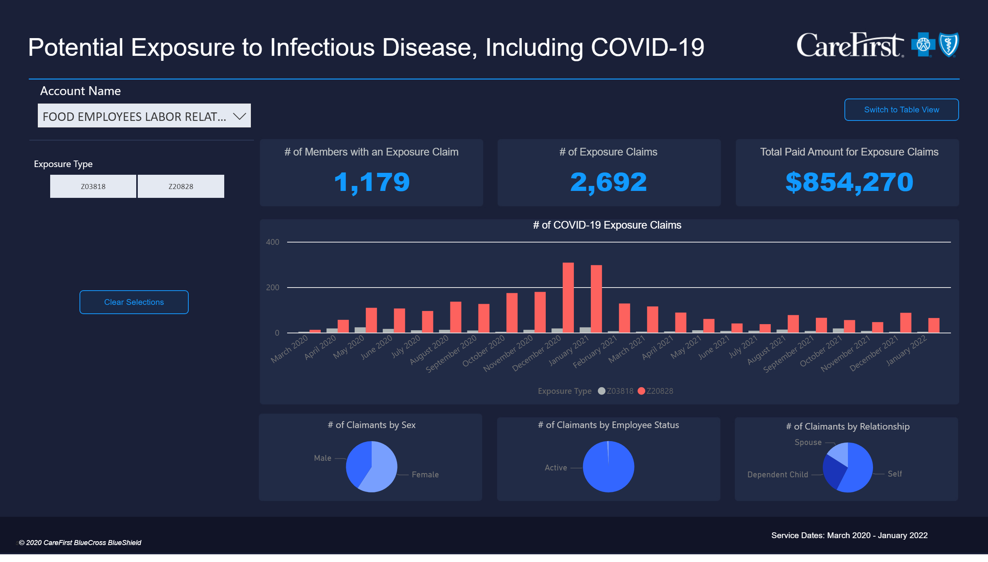
Potential Exposure to Infectious Disease, Including COVID-19
Notes:
# of Claimants by Sex
No alt text provided
# of Claimants by Relationship
No alt text provided
# of Exposure Claims
No alt text provided
textbox
No alt text provided
# of Claimants by Employee Status
No alt text provided
Total Paid Amount for Exposure Claims
No alt text provided
# of COVID-19 Exposure Claims
No alt text provided
Exposure Type
No alt text provided
actionButton
No alt text provided
# of Members with an Exposure Claim
No alt text provided
Account Name
No alt text provided
basicShape
No alt text provided
textbox
No alt text provided
actionButton
No alt text provided
actionButton
No alt text provided
actionButton
No alt text provided
tableEx
No alt text provided
card
No alt text provided

Slide 9
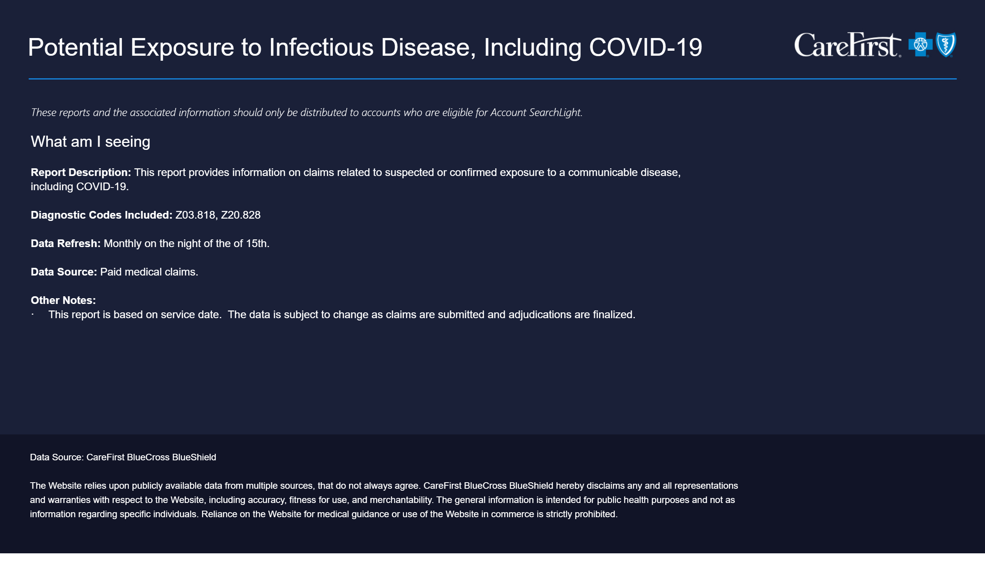
Info Guide - Potential Exposure to Infectious Disease, Including COVID-19
Notes:
textbox
No alt text provided
textbox
No alt text provided
textbox
No alt text provided

Slide 10
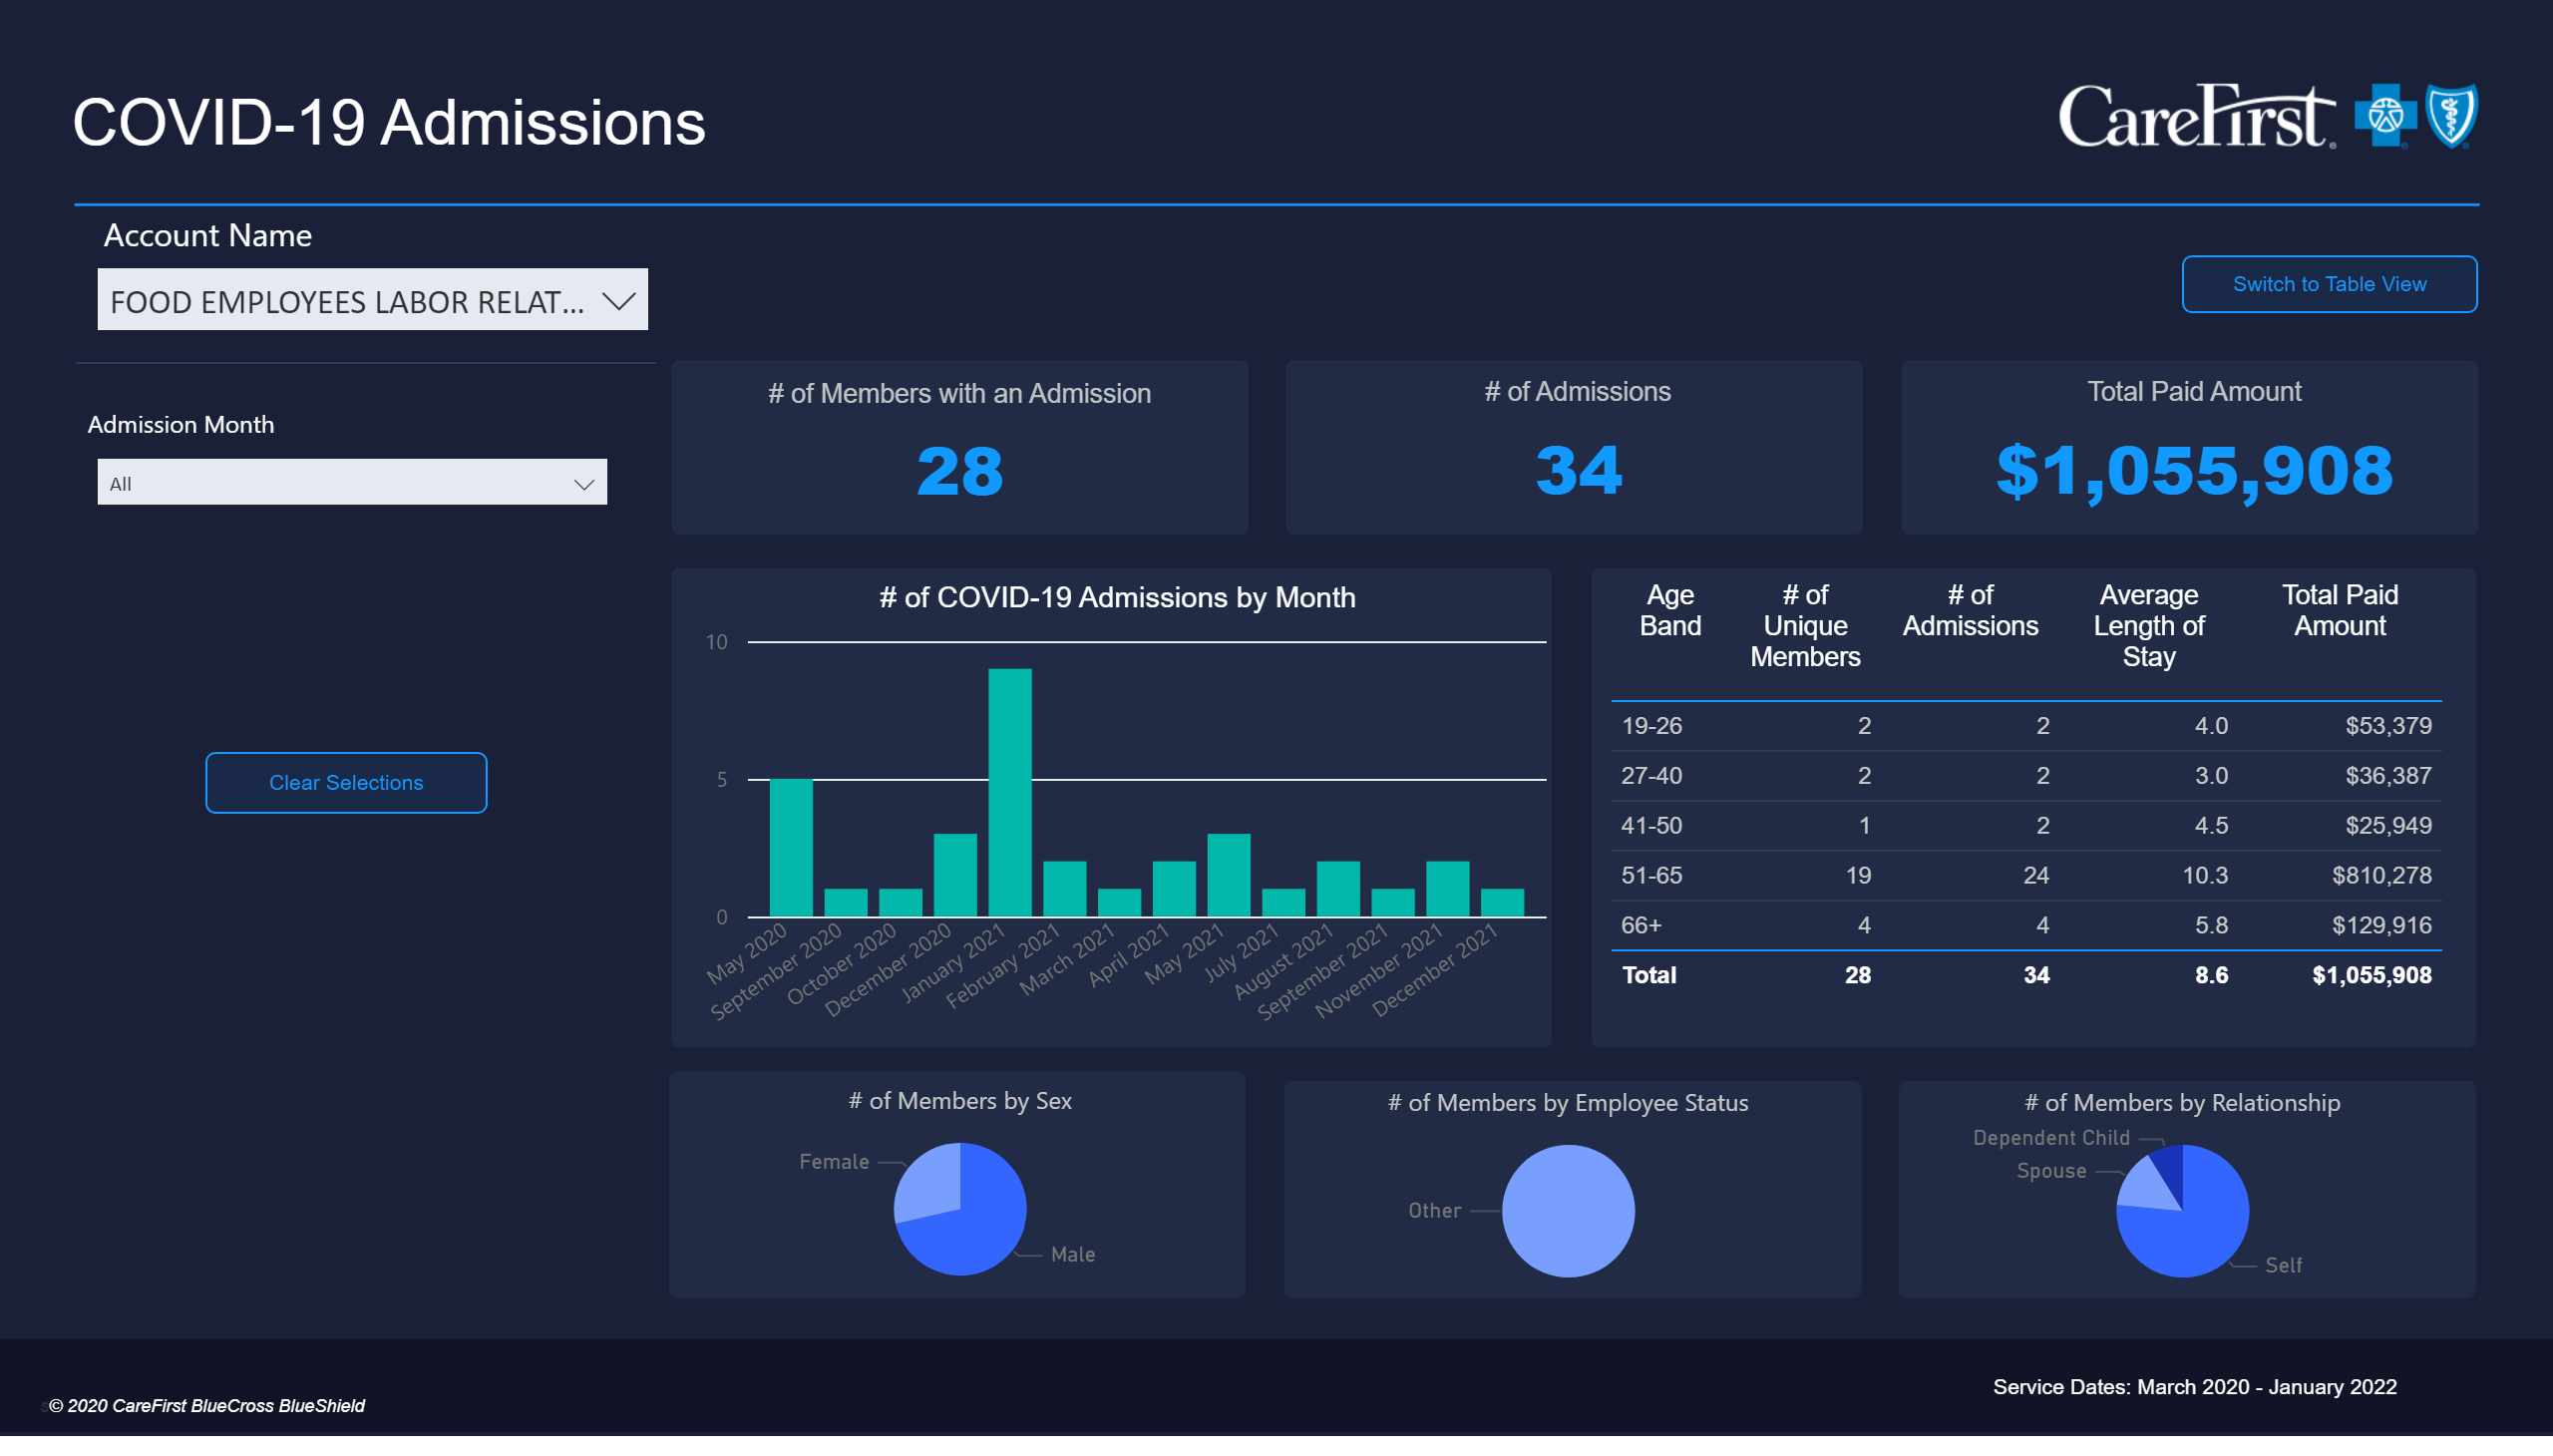
COVID-19 Admissions
Notes:
COVID-19 Related Medical Claims (excluding exposures)
No alt text provided
# of Members with an Admission
No alt text provided
# of Admissions
No alt text provided
Total Paid Amount
No alt text provided
Account Name
No alt text provided
# of COVID-19 Admissions by Month
No alt text provided
textbox
No alt text provided
# of Members by Sex
No alt text provided
# of Members by Employee Status
No alt text provided
# of Members by Relationship
No alt text provided
basicShape
No alt text provided
Admission Month
No alt text provided
card
No alt text provided
actionButton
No alt text provided
textbox
No alt text provided
tableEx
No alt text provided
actionButton
No alt text provided
actionButton
No alt text provided

Slide 11
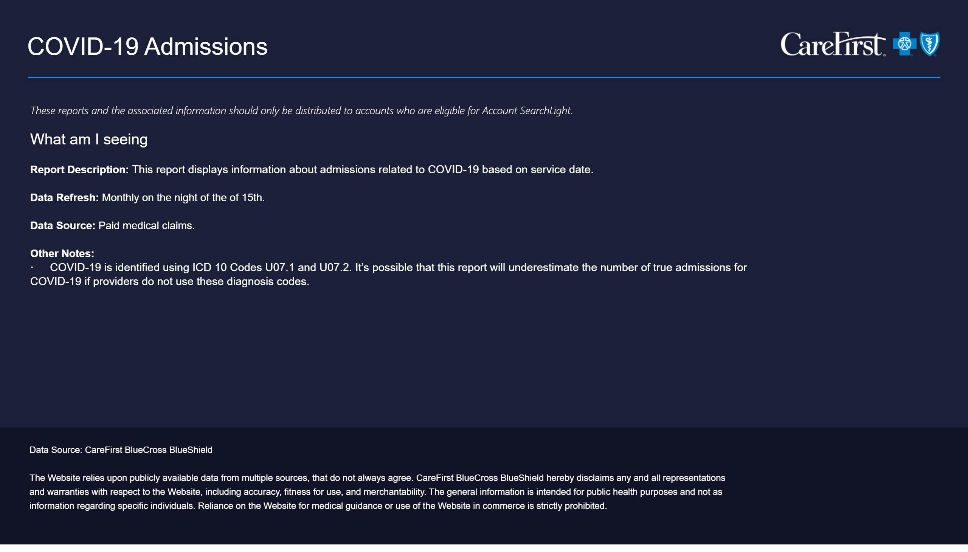
Info Guide - COVID-19 Admissions
Notes:
textbox
No alt text provided
textbox
No alt text provided
textbox
No alt text provided

Slide 12
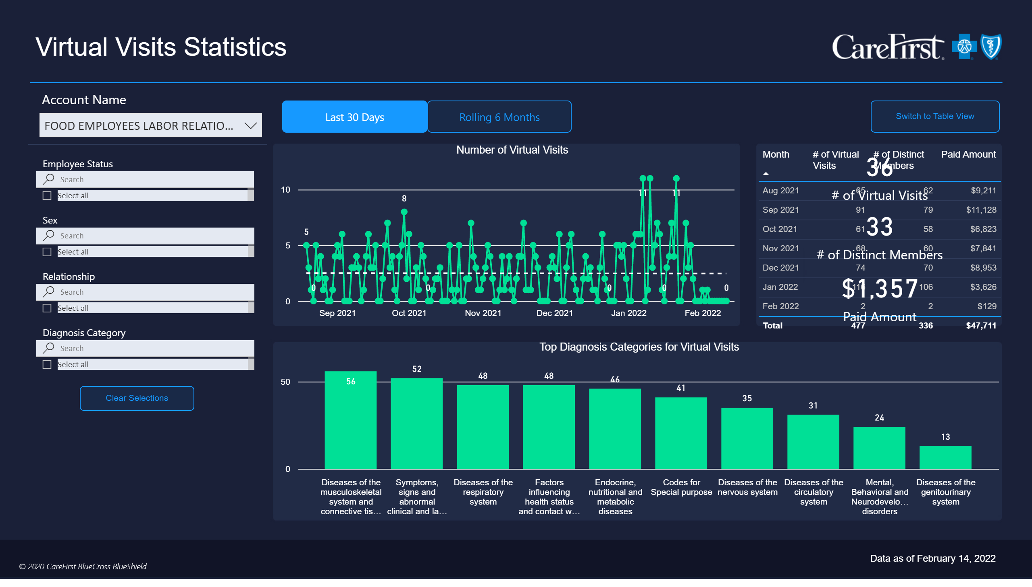
Virtual Visit Statistics
Notes:
Number of Virtual Visits
No alt text provided
slicer
No alt text provided
Top Diagnosis Categories for Virtual Visits
No alt text provided
slicer
No alt text provided
actionButton
No alt text provided
actionButton
No alt text provided
actionButton
No alt text provided
actionButton
No alt text provided
textbox
No alt text provided
slicer
No alt text provided
slicer
No alt text provided
slicer
No alt text provided
actionButton
No alt text provided
actionButton
No alt text provided
actionButton
No alt text provided
actionButton
No alt text provided
tableEx
No alt text provided
actionButton
No alt text provided
actionButton
No alt text provided
actionButton
No alt text provided
actionButton
No alt text provided
actionButton
No alt text provided
actionButton
No alt text provided
actionButton
No alt text provided
actionButton
No alt text provided
tableEx
No alt text provided
basicShape
No alt text provided
textbox
No alt text provided
card
No alt text provided
card
No alt text provided
card
No alt text provided
card
No alt text provided

Slide 13
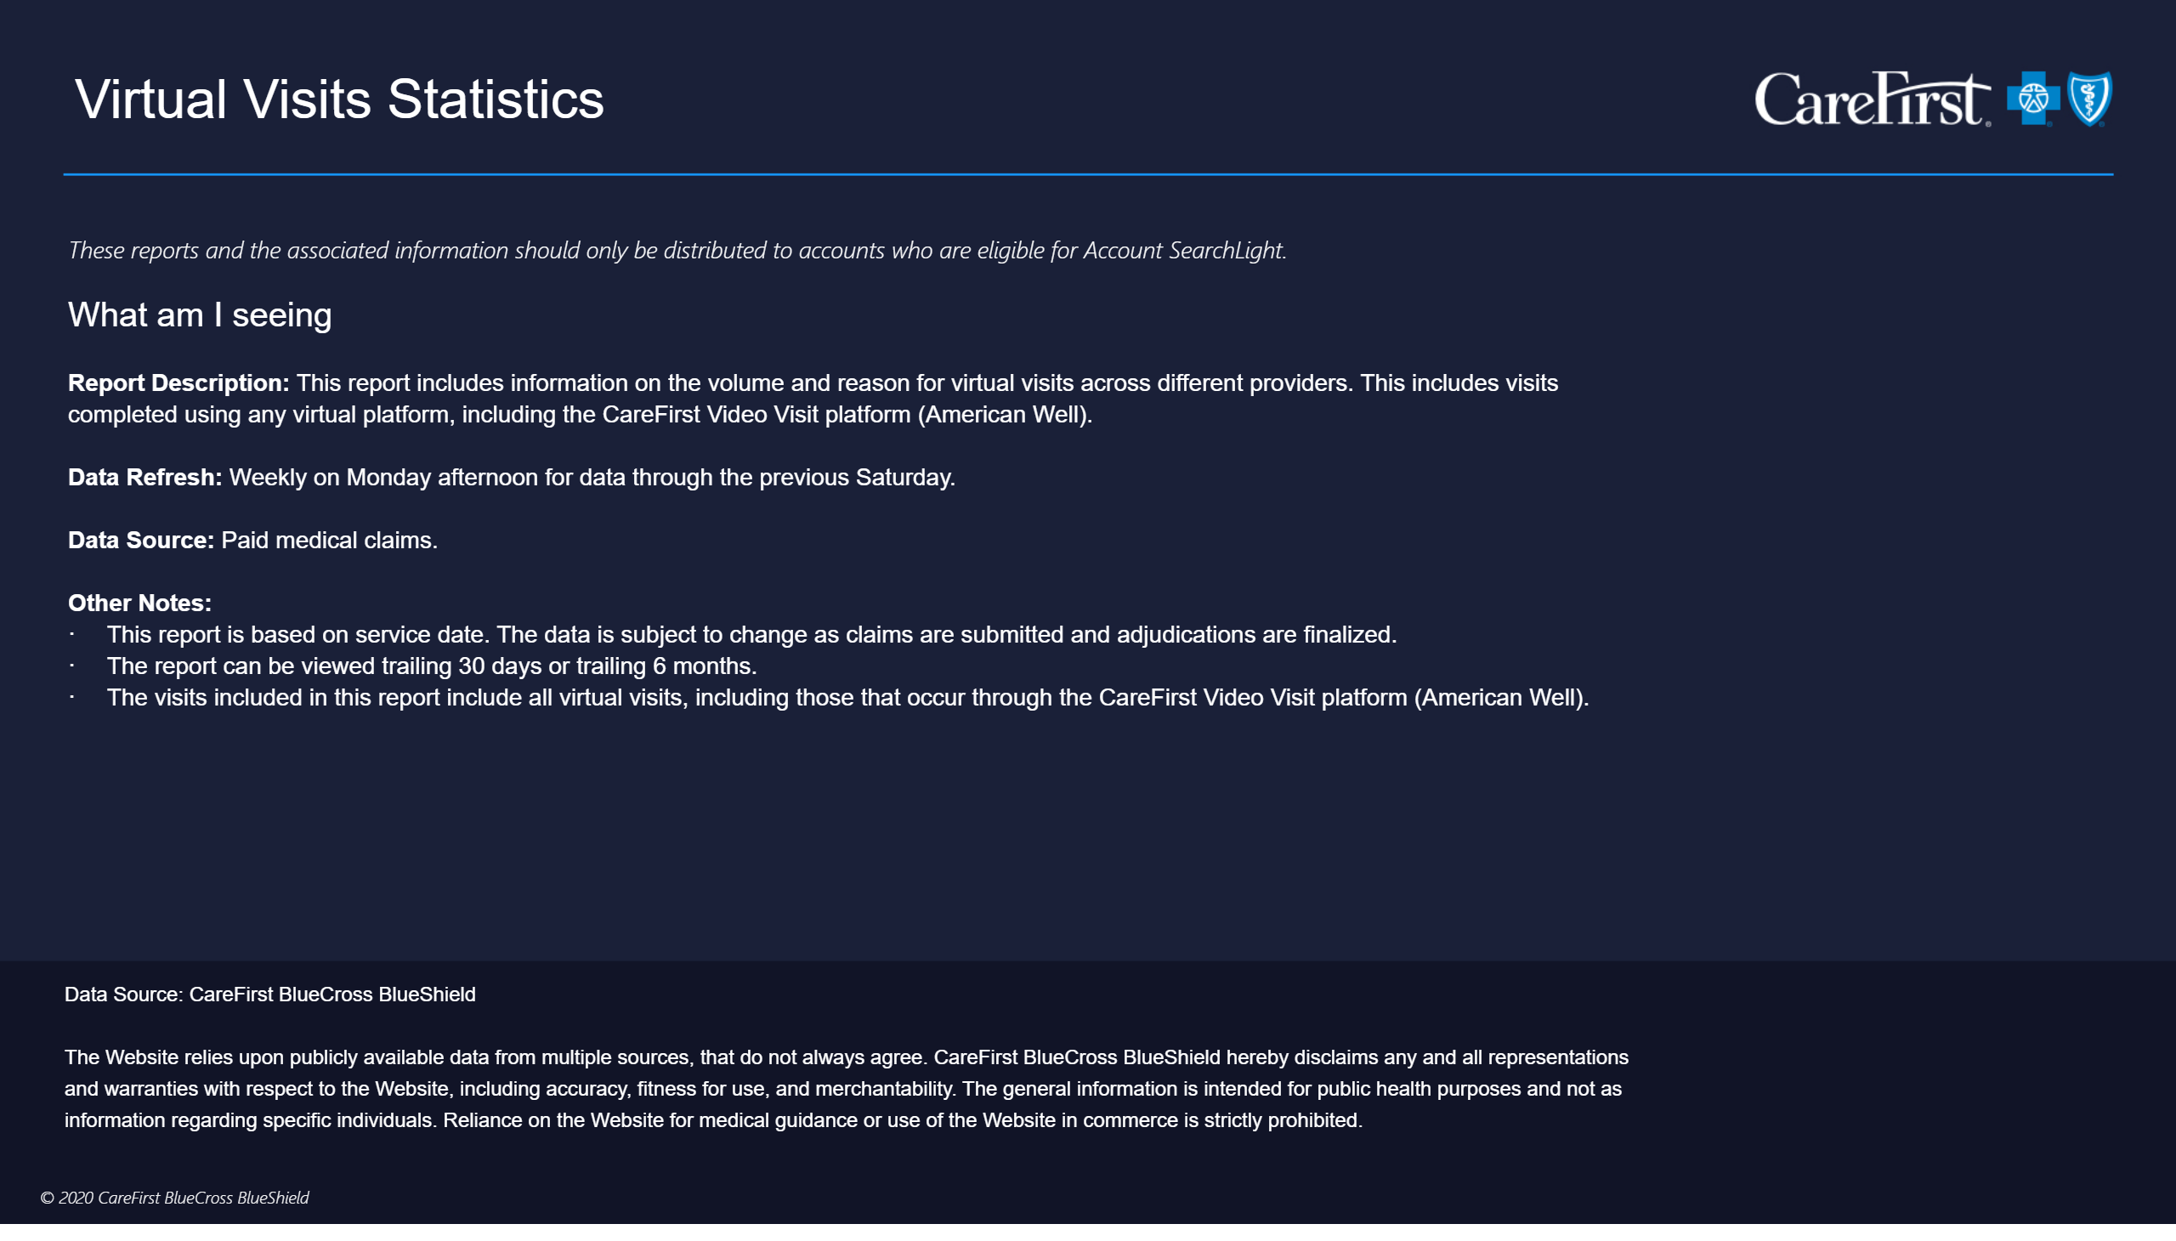
Info Guide - Virtual Visit Statistics
Notes:
actionButton
No alt text provided
actionButton
No alt text provided
lineChart
No alt text provided
columnChart
No alt text provided
map
No alt text provided
textbox
No alt text provided
textbox
No alt text provided
textbox
No alt text provided
textbox
No alt text provided

Slide 14
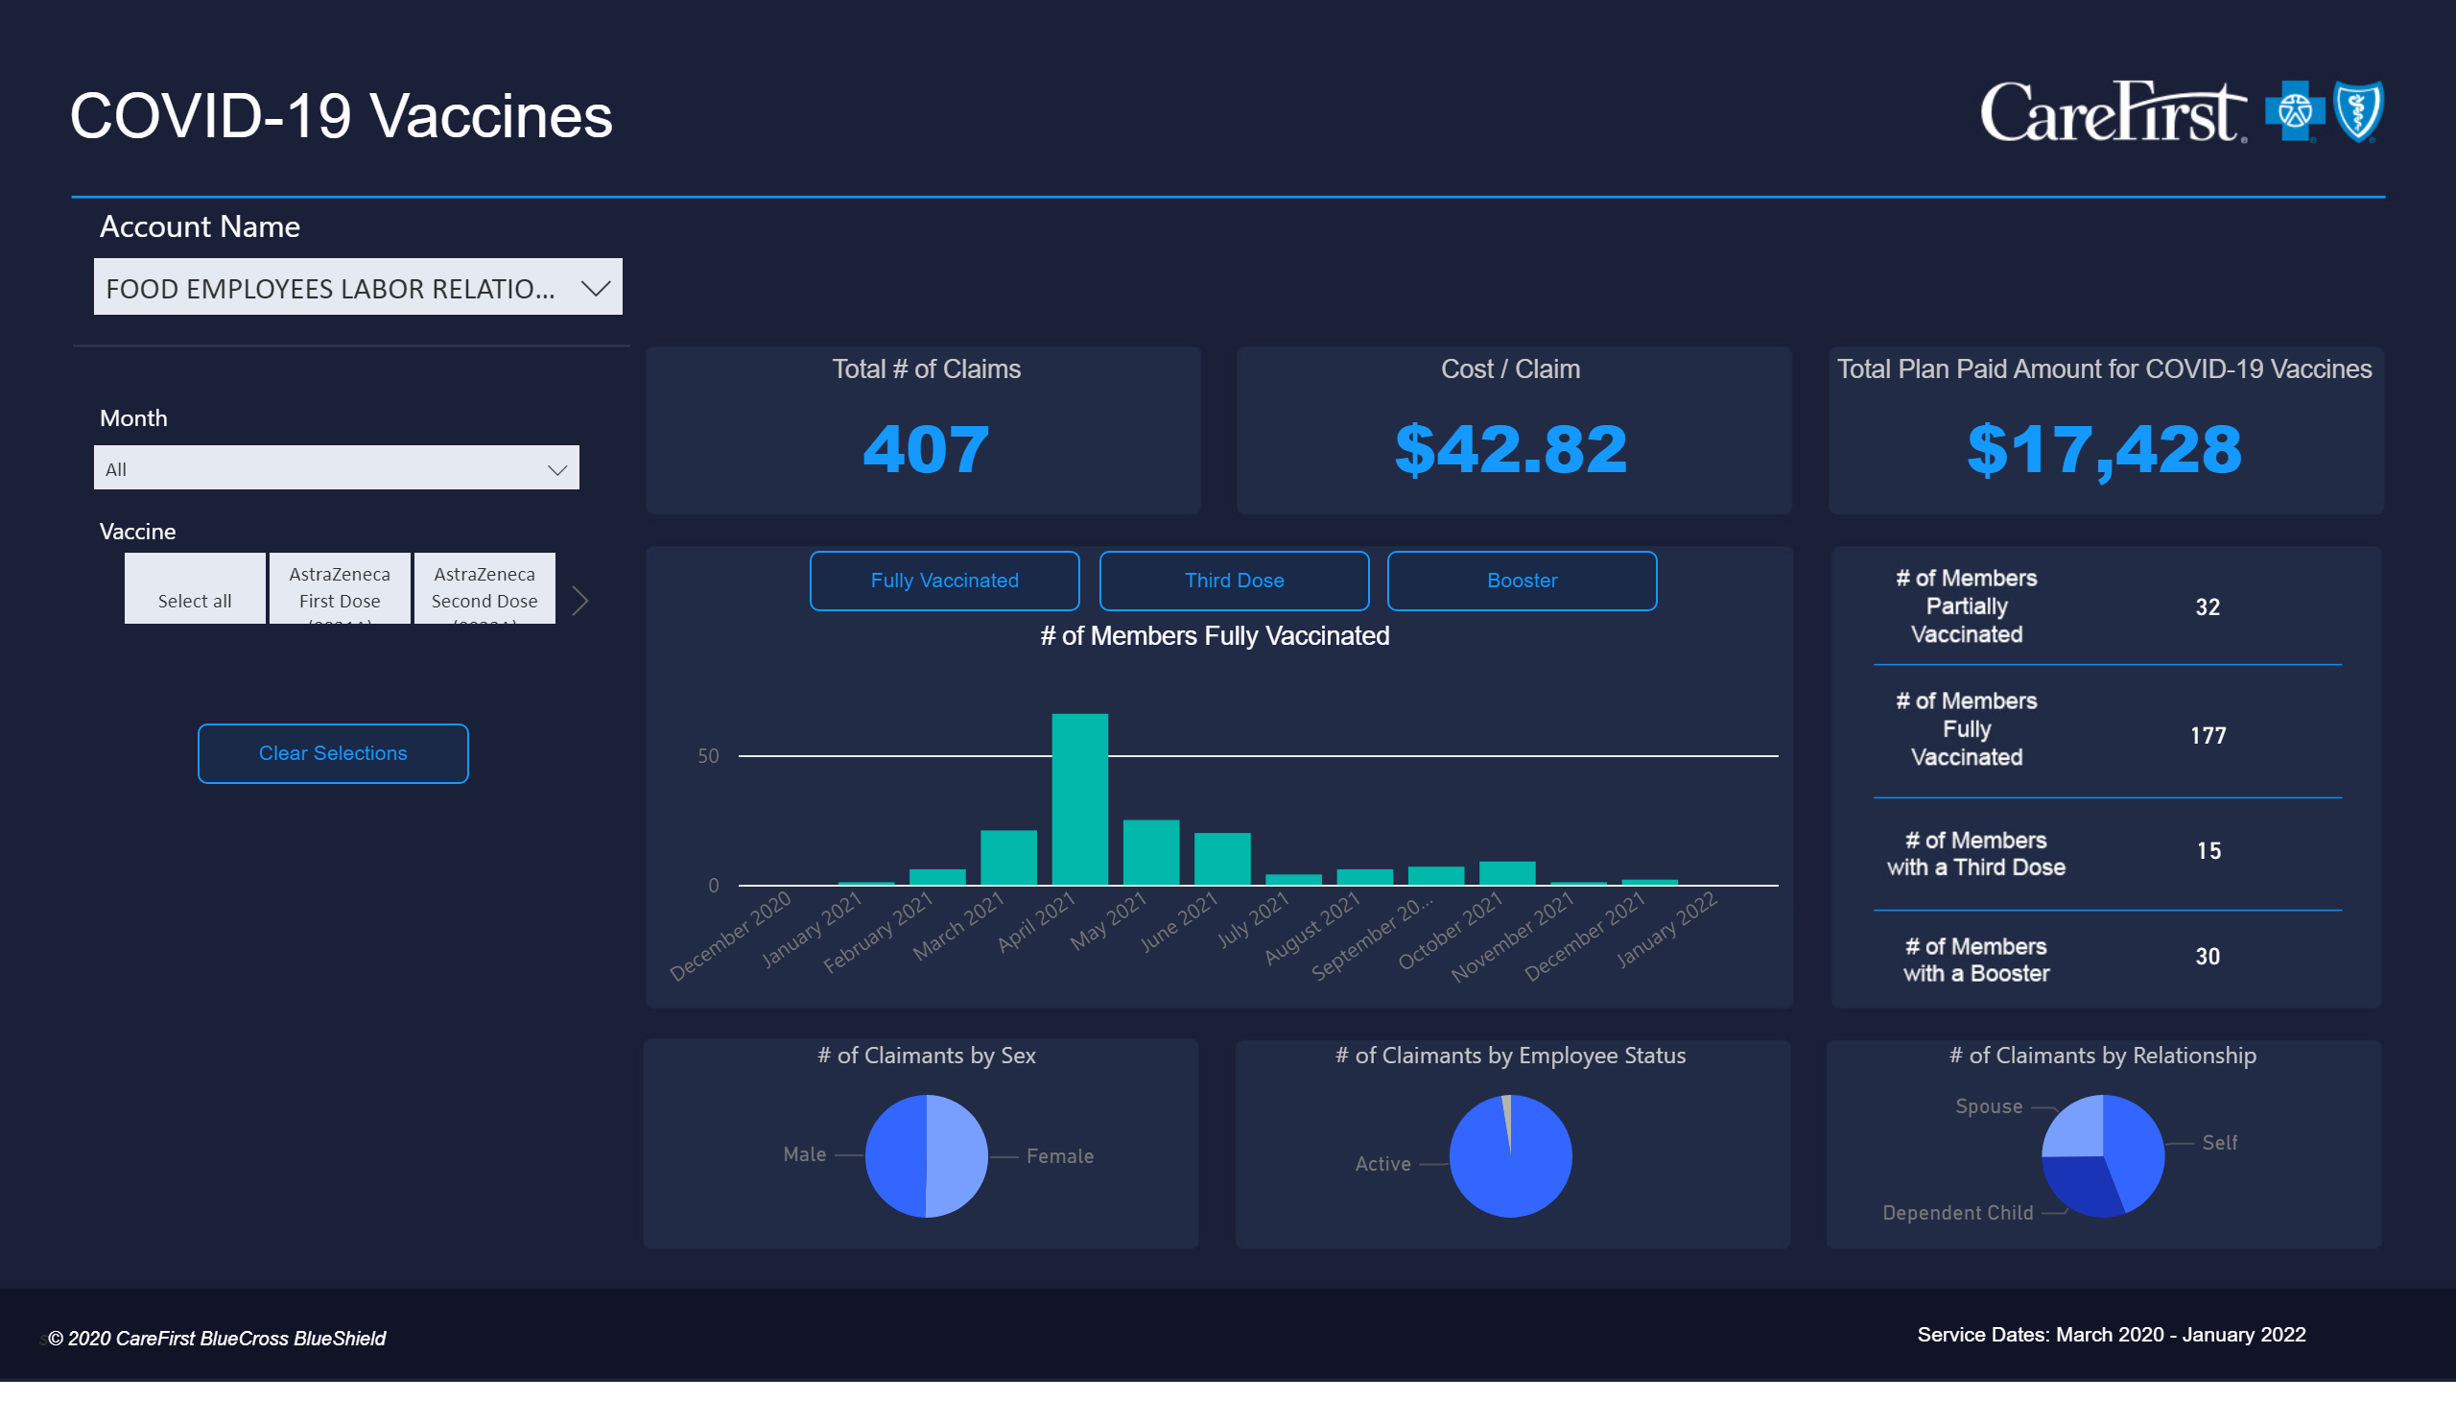
COVID-19 Vaccines
Notes:
Cost / Claim
No alt text provided
textbox
No alt text provided
actionButton
No alt text provided
Procedure Code
No alt text provided
Total Plan Paid Amount for COVID-19 Vaccines
No alt text provided
Total # of Claims
No alt text provided
# of Members Fully Vaccinated
No alt text provided
Account Name
No alt text provided
# of Claimants by Sex
No alt text provided
# of Claimants by Employee Status
No alt text provided
# of Claimants by Relationship
No alt text provided
basicShape
No alt text provided
textbox
No alt text provided
actionButton
No alt text provided
actionButton
No alt text provided
tableEx
No alt text provided
card
No alt text provided
card
No alt text provided
tableEx
No alt text provided
actionButton
No alt text provided
actionButton
No alt text provided
card
No alt text provided
card
No alt text provided
card
No alt text provided
Procedure Code
No alt text provided
columnChart
No alt text provided
columnChart
No alt text provided
actionButton
No alt text provided
actionButton
No alt text provided
actionButton
No alt text provided

Slide 15
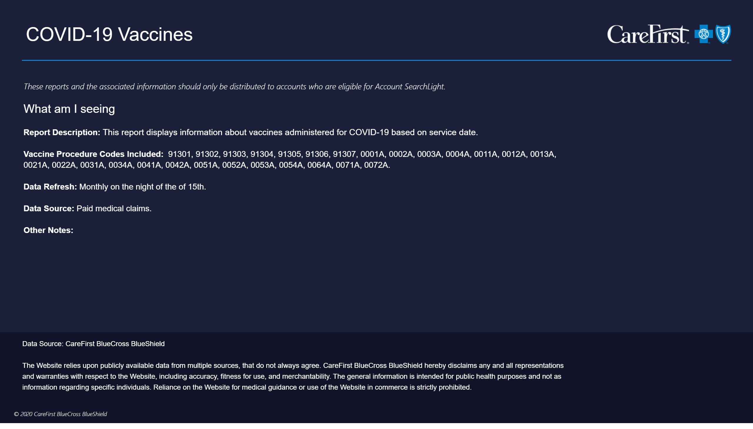
Info Guide - COVID-19 Vaccines
Notes:
actionButton
No alt text provided
actionButton
No alt text provided
lineChart
No alt text provided
columnChart
No alt text provided
map
No alt text provided
textbox
No alt text provided
textbox
No alt text provided
textbox
No alt text provided
textbox
No alt text provided

